Slide 1
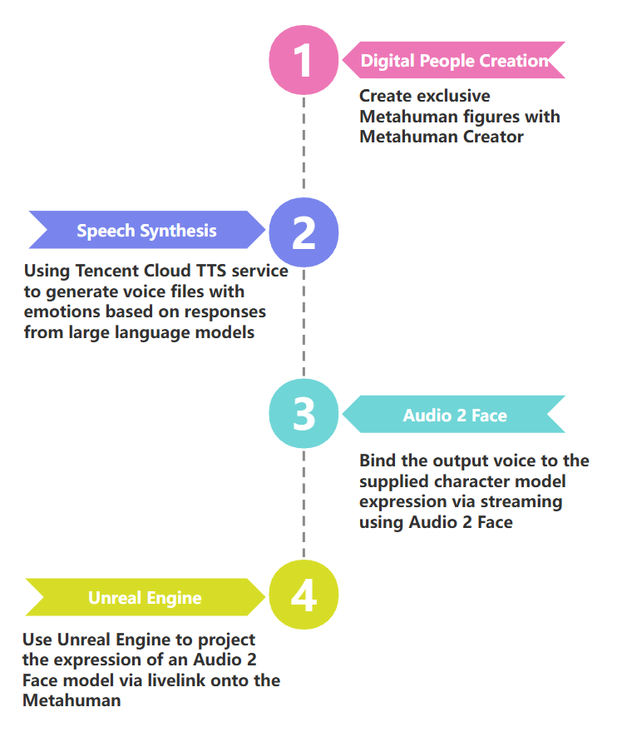
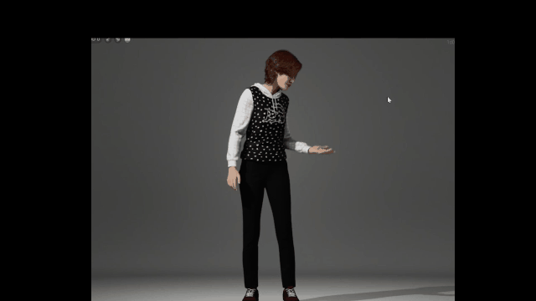
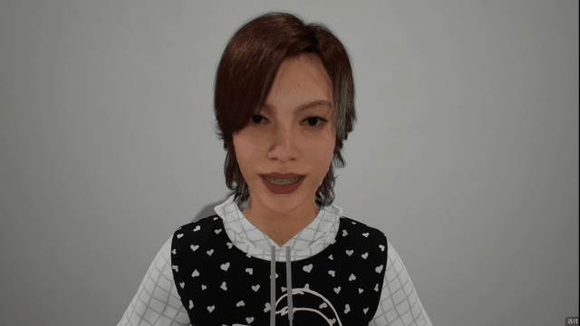
02
Digital Human Module——content construction
In order to enhance user immersion and human-computer interaction.
标题文字添加

Slide 2
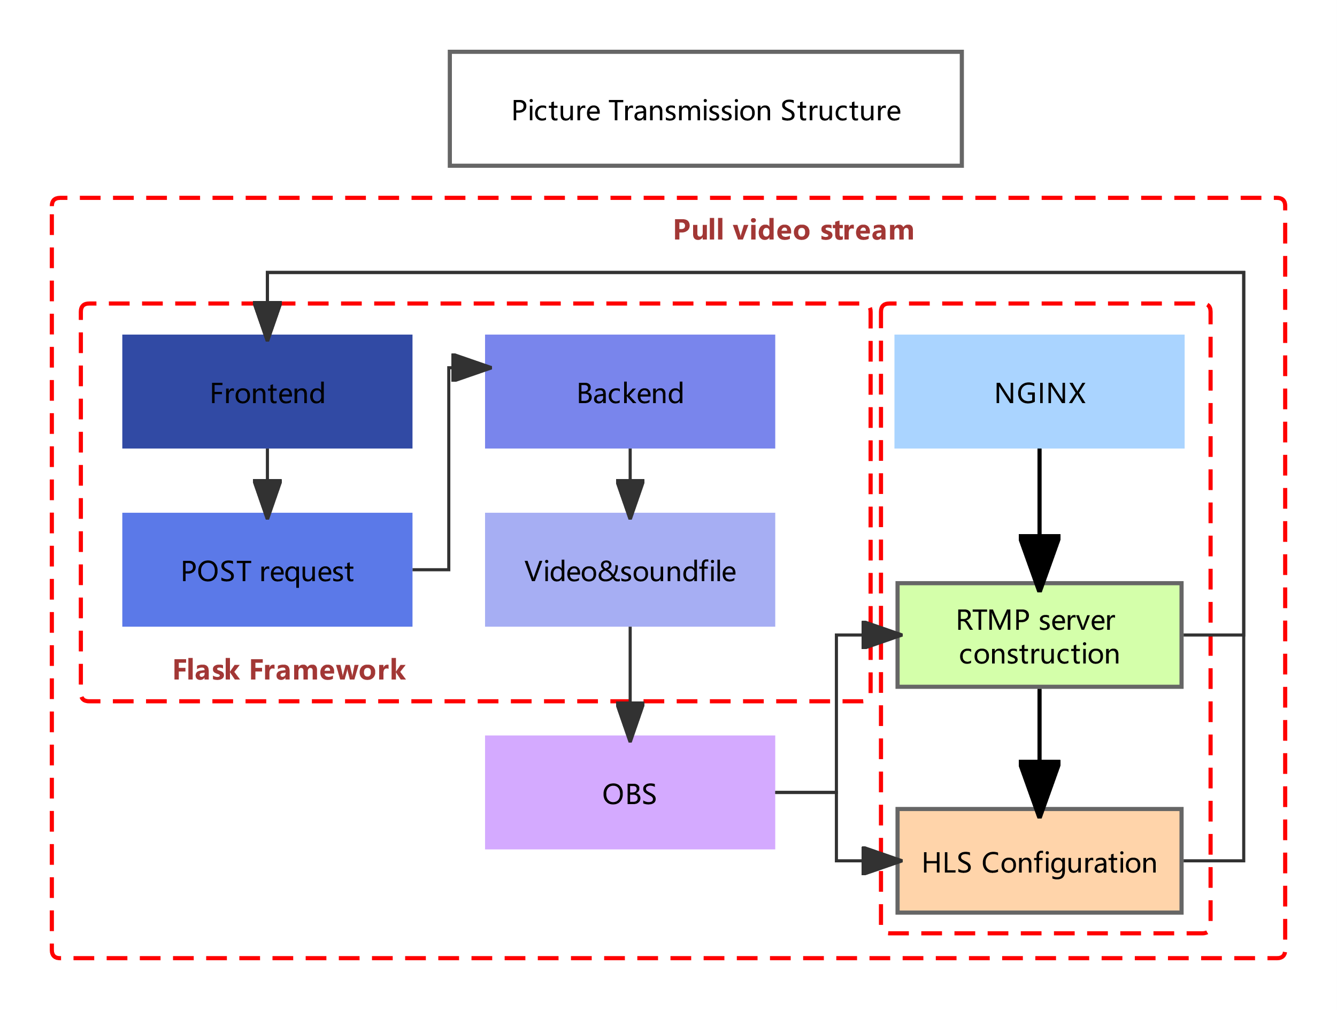


02
Digital Human Module——picture transmission
In order to enhance user immersion and human-computer interaction.
Engine X
Flask Framework

